Slide 1

TEAM AND COMPANY
Full Name - Role
Full time or Part-time
Monthly Salary (S$):
Based in (Country):
Experience:
Name of Company: ________ Pte. Ltd.
ACRA Business No.:
URL: http://
Incorporated in DD/MMM/YYYY
No. of Employees:
Name of Investors:
Name of Advisors:
Total capital raised so far (S$):
Capital sought for this round(S$):
For Equity (%) or SAFE:
Cash @ Bank (S$):
Total revenue to date (S$):
Current monthly revenues (S$):
Current monthly expenses (S$):
Total Grant(s) from Gov (S$):
Name of Grant(s):
Outstanding Debt (S$):
Most Recent Capital Investment [MRCI](S$):
Equity Given for MRCI (%):
Date for MRCI (%):
Name of MRCI’s Investor:
Current valuation (S$):
Basis of Current valuation:
Full Name - Role
Full time or Part-time
Monthly Salary (S$):
Based in (Country):
Experience:
Full Name - Role
Full time or Part-time
Monthly Salary (S$):
Based in (Country):
Experience:

Slide 2
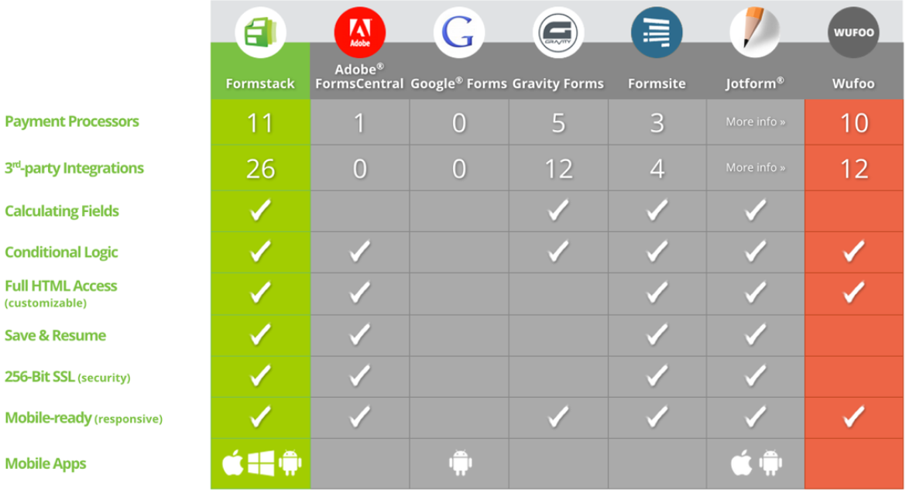
COMPETITORS
[Good if you are able to compare your product features with other competitors]

Slide 3

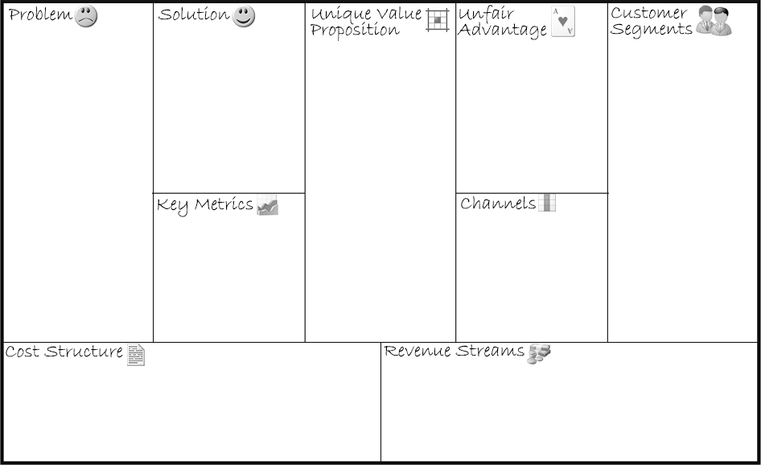




Solution, S
Outline a possible solution for each problem
P1:
P2:
S1:
S2:
Channels, C
List your path to customers;
Through which Channels do our Customer Segments
want to be reached?
How are we reaching them now?
How are our Channels integrated?
Which ones work best?
Which ones are most cost-efficient?
How are we integrating them with customer routines?
V1:
V2:
U1:
U2:
CS1:
CS2:
Revenue Stream, RS
List your sources of revenue:
Revenue Model
Lifetime Value
Revenue
Gross Margin;
For what value are our customers really willing to pay?
For what do they currently pay?
How are they currently paying?
How would they prefer to pay?
How much does each Revenue Stream contribute to overall revenues?
Problem, P
List your customer’s top 3 problems
K1:
K2:
C1:
C2:
Customer Segments, CS
List your target customers and users;
For whom are we creating value?
Who are our most important customers?
Cost Structure, CO
List your fixed and variable costs:
Customer Acquisition Costs
Distributed Costs
Hosting
People, etc.;
What are the most important costs inherent in our business model?
Unique Value Proposition, V
Single, clear compelling message that turns an unaware visitor into an interested product
CO1:
CO2:
CO3:
CO4:
RS1:
RS2:
RS3:
RS4:
Key Metrics, KM
List the key numbers that tell you how your business is doing
[Team member], UA
Something that can’t be easily copied or brought
PRODUCT MARKET
Notes:
Background to Lean Canvas: https://leanstack.com/lean-canvas
Source of Lean Canvas Template: http://invcapital.com/pub/Lcanvas
Actual Examples:
-----------------------------------------------------------------------------------------------------------------
Recommended sequence of Inputs: P -> CS -> V -> S -> C -> RS -> CO -> KM -> UA
Versions: 2016: v1 © Dr. [Third party] dr(at)ye.sg

